Slide 1
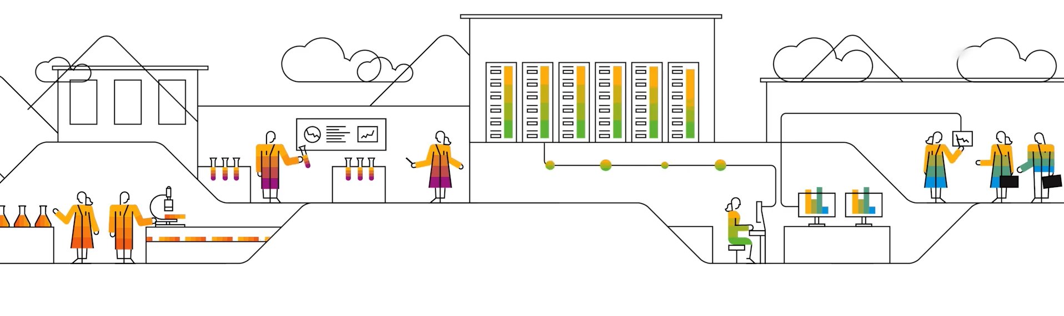

Process Transformation Suite
Aum Manoj Chaudhari​
Garima Anand​
Kaleb William Kontak​
Surshita Kanakprasad Cheripalli​

Slide 2

Agenda
What is Signavio ?
Why Signavio ?
How Signavio Works ?
Success Stories
Shortcomings
Alternatives
Conclusion

Slide 3


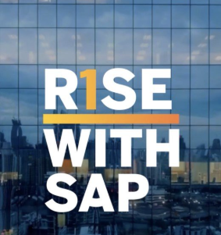


Introduction​
Cloud based
Business Process Management tool
Offered as essential component of Rise with SAP starter pack
Key Component of SAP Business Transformation Suite
Enable organization to understand ,innovate and transform business processes
ThePhoto by PhotoAuthor is licensed under CCYYSA.

Slide 4


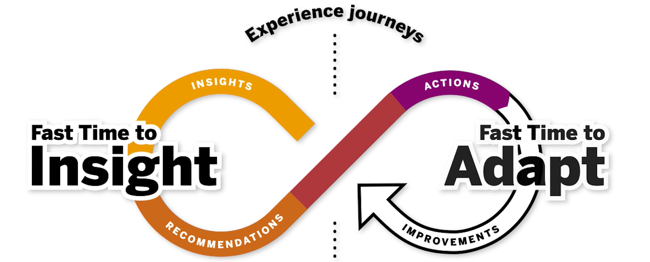
Why Signavio ?
BPM for All
All in one Business Process Management solution
Customer at the center
Single source of truth
Focus on future
Change the way of doing business
Adapt to customer needs
Notes:
Agile cloud based tool with latest updates , driven by white papers and best practices guides
SAP Signavio Collaboration Hub is an open and engaging central digital meeting place where users share process-related knowledge. It allows any organization to create a single source of truth, where the most recent version of every policy, procedure, and process can be stored, and more importantly, accessed by all employees.
SAP Signavio Collaboration Hub also supports process development and editing in real time. Participants can offer direct feedback, with commenting available at an individual task and a process level.
supporting your business to make best use of robotic process automation, or helping you integrate customer journey maps into your existing processes.

Slide 5
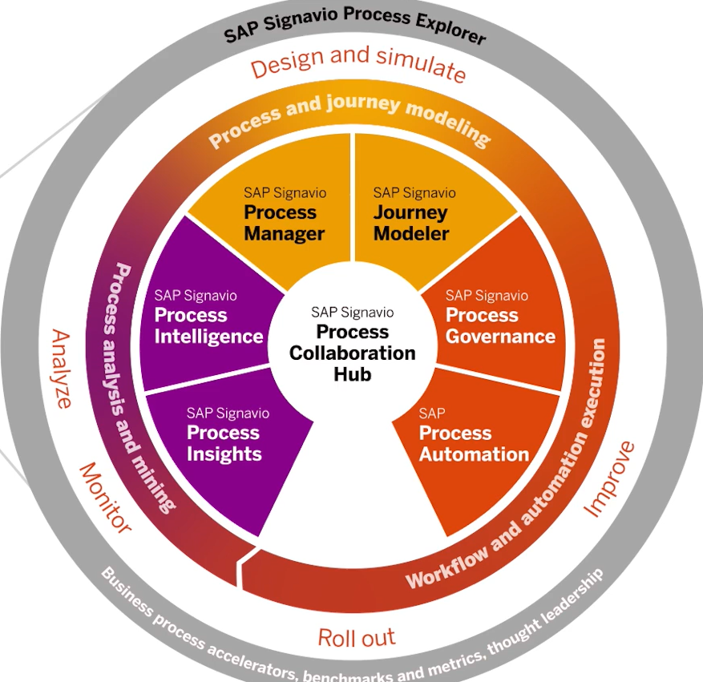
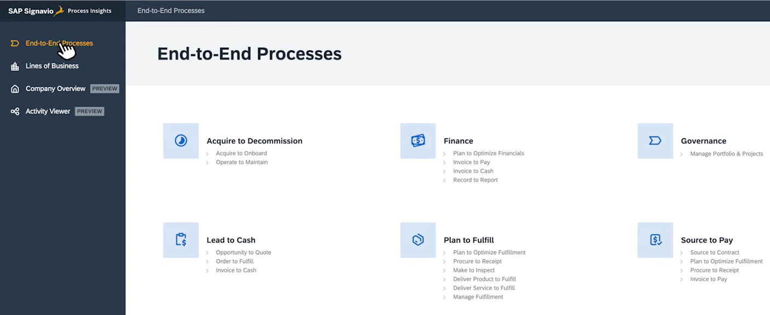
How Signavio Works ? Process Analysis And Mining : Process Insights

Slide 6
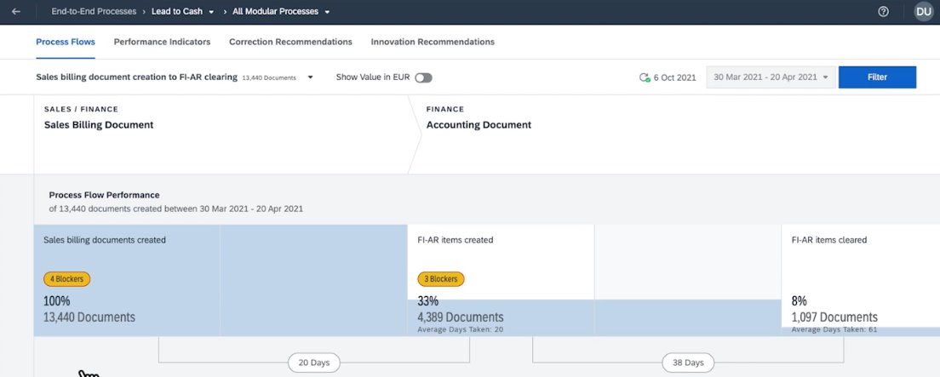
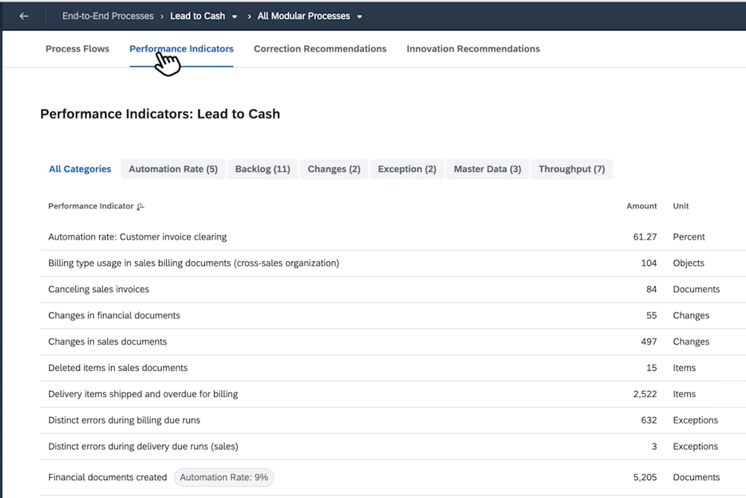
Process Analysis And Mining - Process Insights
Process Flows
Performance Indicators

Slide 7
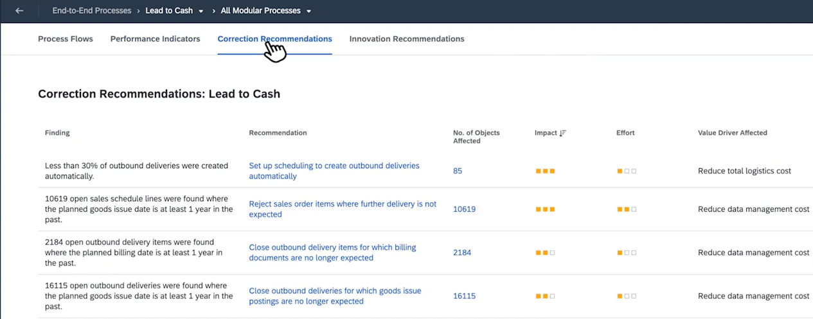
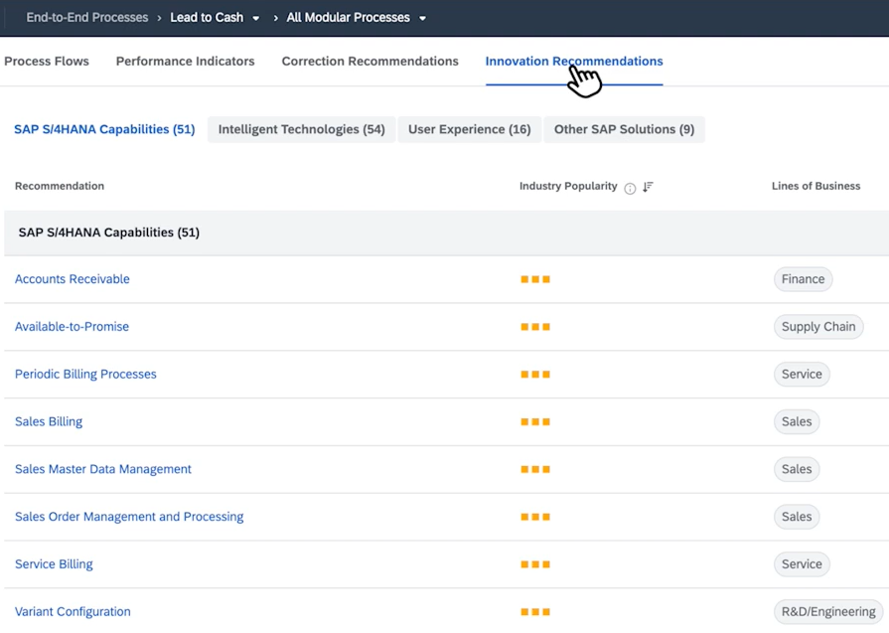
Process Analysis And Mining : Process Insights
Correction Recommendations
Innovation Recommendations

Slide 8
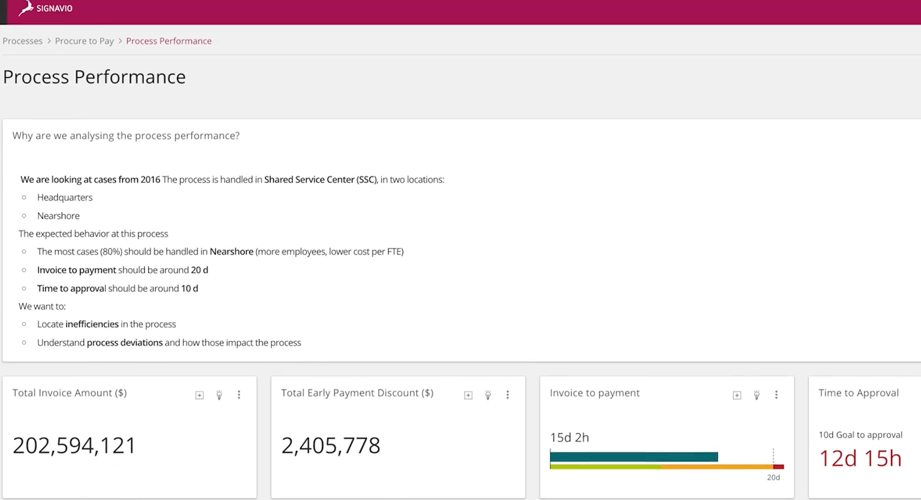
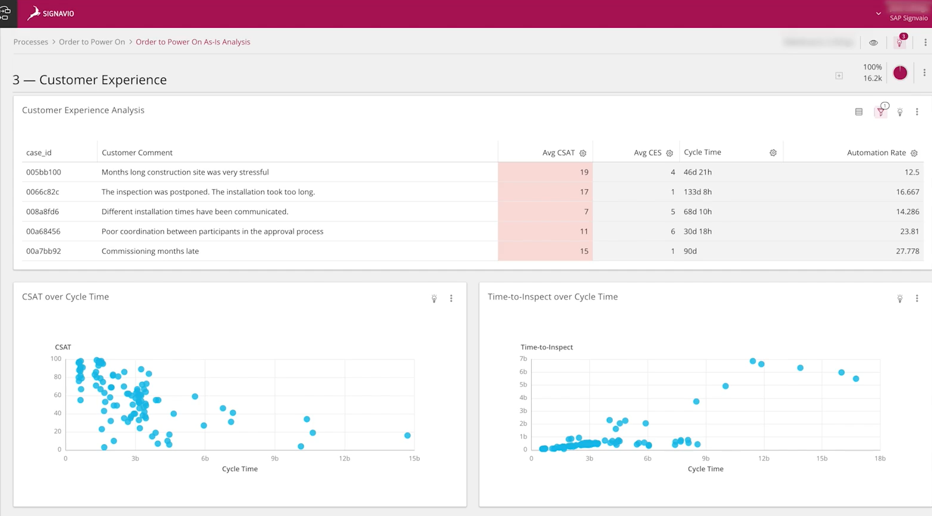
Process Analysis And Mining : Process Intelligence
Investigating operation and experience data and presenting in notebook style canvases
Enables process analysts to create full data story from problem discovery to context framing
Notes:
Focuses on the broader process intelligence capabilities. Enables end-to-end storytelling from identifying problems to contextualizing them with data. Information is presented in interactive, notebook-style canvases, merging operational and experience data. Supports process analysts in framing issues and strategizing improvements.

Slide 9
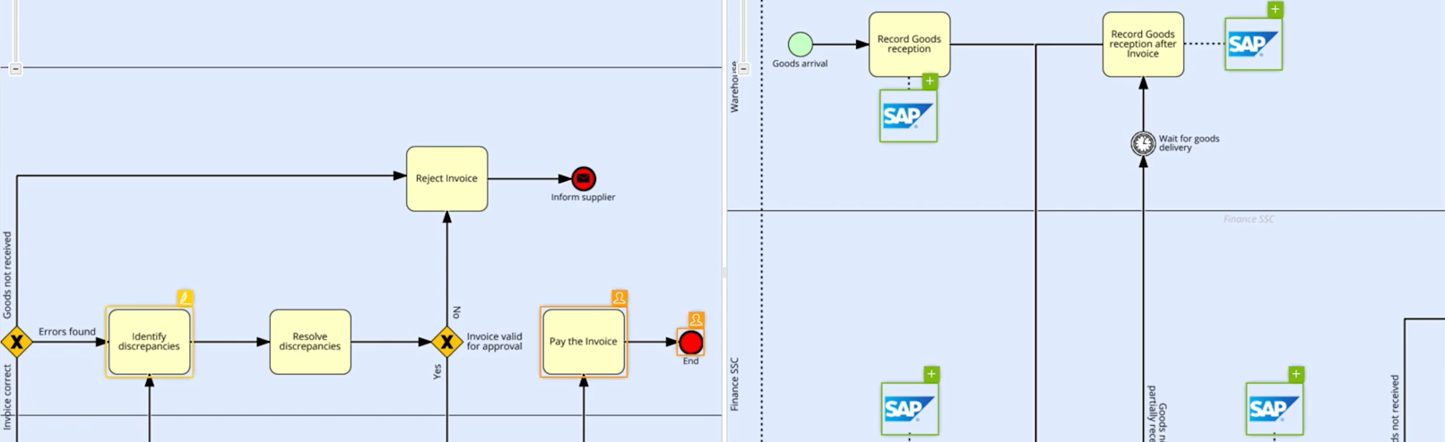
Process And Journey Modelling : Process Intelligence
Inside-out view of business
Compare and simulate
Notes:
Discusses the "inside-out" view of business processes. Compares and simulates various process models to understand impacts and effectiveness. Useful for identifying best-performing processes and refining existing operations. Encourages continuous process improvement and experimentation.

Slide 10
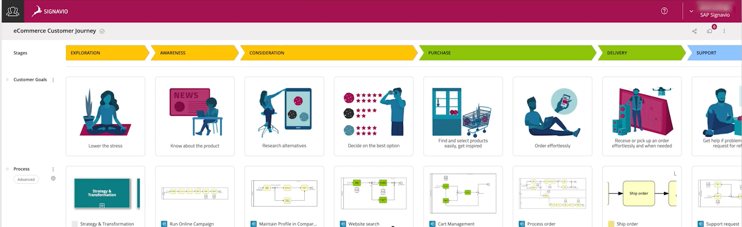
Process And Journey Modelling : Journey Modeler
Outside-in view of business
Operationalize customer experience by experience-driven process management
Notes:
Connects Customers to processes, metrics, systems , which enables to improve how real people experience the operations of business . Allows to design visually appealing customer journeys
Complements the previous slide with an "outside-in" view focusing on the customer experience. Aims to operationalize customer feedback and insights into process design. Helps businesses align internal operations with customer expectations and satisfaction. Promotes experience-driven process management.

Slide 11
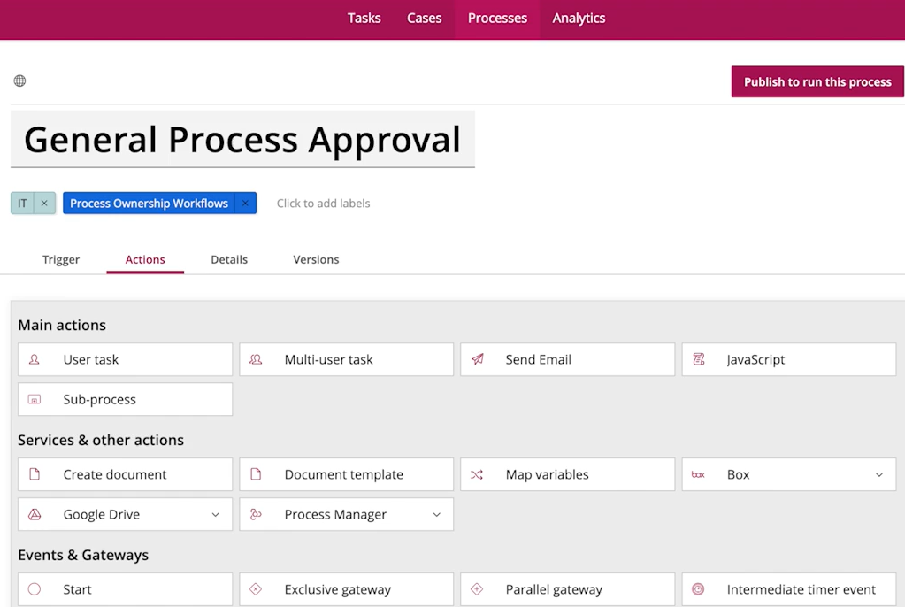
Workflow And Automation Execution : Process Governance
Provides ability to manage, govern and roll out of process
Supports in maintaining structured and compliant content repository , speed up process improvement
Notes:
Introduces governance features that help manage and roll out processes effectively. Emphasizes structured, compliant content repositories to ensure consistency.
Speeds up process improvement cycles by maintaining clear documentation and standards. Aids in governance, version control, and team collaboration across processes.

Slide 12
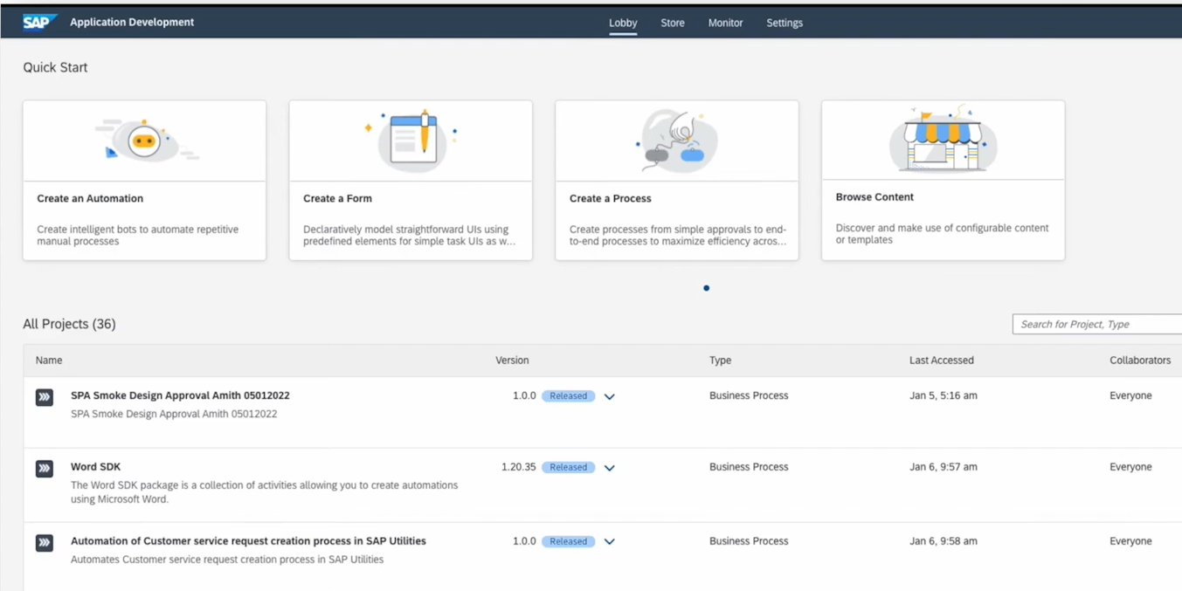
Workflow And Automation Execution : Process Automation
Allow to leverage power of intelligent robotic process automation, workflow and low-code no-code capabilities
Reduced manual intervention ,support error-free and scalable tasks
Notes:
This slide focuses on how SAP Signavio leverages automation to enhance business processes. It enables organizations to use intelligent robotic process automation (RPA), along with workflow orchestration and low-code/no-code platforms. The key benefit is reduced manual intervention, which leads to Fewer human errors, Faster execution and Scalable and repeatable processes. It empowers business users and IT to automate routine tasks, making the system more agile and efficient. This module is crucial for businesses aiming to modernize legacy workflows and boost operational efficiency.

Slide 13
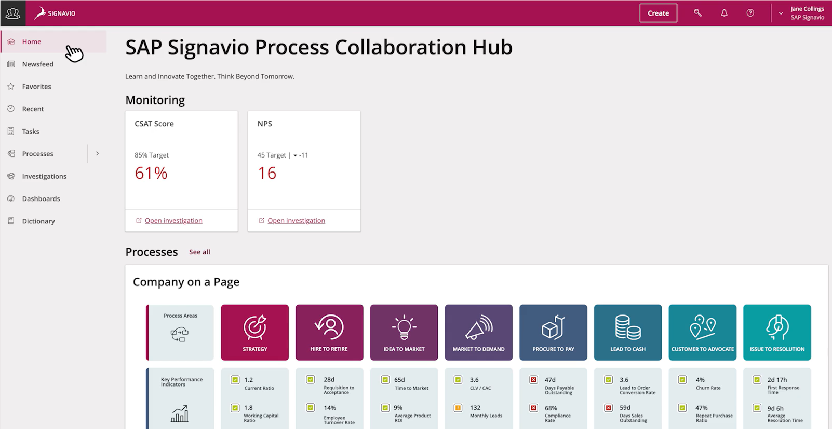
SAP Signavio Process Collaboration Hub
Review
Publish
Share and Collaborate
Notes:
This slide introduces the Collaboration Hub, a central platform for teams to review, publish, share, and collaborate on business processes. It promotes transparency and alignment across departments by offering a single source of truth for process documentation. Stakeholders can contribute feedback, stay informed about process updates, and collaborate in real-time. The hub simplifies communication between business and IT teams, ensuring that everyone works toward the same goals. Overall, it strengthens collaborative process governance, making process improvement a shared responsibility across the organization.

Slide 14
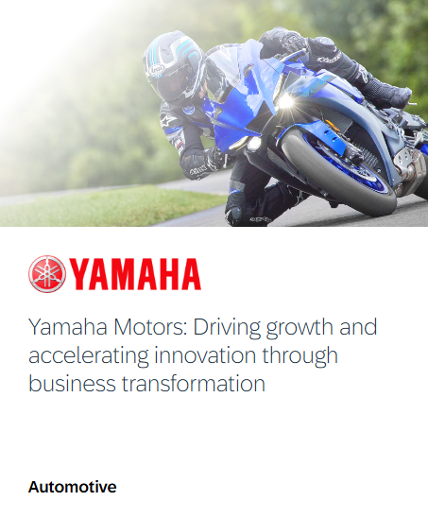
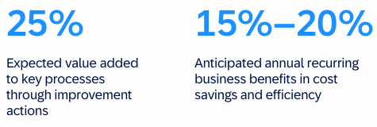
SAP Signavio Success Stories
Before -> Challenges and opportunities
Lack of process visibility, difficulty in process implementation
Communication challenges between business and IT on access to process information
After -> Value Driven Results
Formal organization-wide business process documentation
Enhanced visibility
Effective, efficient and smooth process enhancement

Slide 15
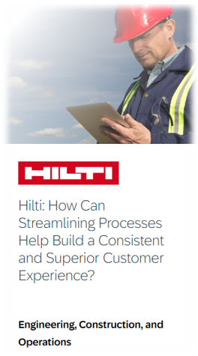
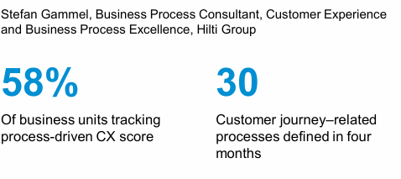
SAP Signavio Success Stories
Before -> Challenges and opportunities
Introduction of new corporate goal a customer experience (CX) score of 95% across the business by 2030
Difficulty connecting customer experience data with operational data due to a scattered analytics landscape
​
After -> Value Driven Results ​
​
Clarity in roles, responsibilities and expectation for process owners
Revitalizing process organization
Forged framework focused on Customer experience globally

Slide 16

SAP Signavio Integration for Partners
Understand Enterprise processes with SAP Signavio Process Discovery
Measure outcomes using Process Intelligence
Automate using Automation Anywhere Platform
Identify Inefficiencies and root cause
Accelerate remediation using Process discovery document
Post Implementation improvements from SAP Signavio

Slide 17

Before - SAP process data was siloed, making it hard to combine with non-SAP data for analytics. - Limited ability to use AI/ML models on business process data.
After - Real-time, bi-directional data sharing between SAP and Databricks removes data silos. - AI/ML models can be directly applied to SAP Signavio process data for advanced analytics and risk detection.
What is Integrated?
SAP Signavio’s Process Intelligence and Process AI integrate with Databricks via SAP Business Data Cloud
Notes:
Siloed – isolated

Slide 18






Shortcomings of Signavio
Difficulty in integration
Limited versatility
Inadequate document management
Complexity in Integration with other software
Challenge in report customization
Additional integration required for document flows
Collaborative features
Analytical capability
Requirement for real-time comment notifications
Scope for incorporation of AI and machine learning .

Slide 19

Alternatives to SAP Signavio: Celonis
Celonis is a business process mining tool:
Analyzes data from IT systems
Real-time insights to improve performance
AI-integration to automate workflow and offer improvements
How Celonis differs from SAP Signavio:
Celonis is more focused on current processes and less simulation
Ex. Duplicate accounts payable, resolving order management delays
Stronger use of AI tools and integration

Slide 20

Alternatives to SAP Signavio: iGrafx
iGrafx is a simple, web based business process management tool:
Process modeling and process mining systems
Risk mitigation systems built into process modeling and simulations
Discover – Desing – Optimize
How iGrafx differs from SAP Signavio:
Used more for risk management
Ex. Accounting/FI, Pharma, and Aerospace
Made for flexibility, both Cloud on On-site

Slide 21

Alternatives to SAP Signavio: Microsoft Power Automate
Microsoft Power Automate is a low code business process automation solution:
Uses task and process mining to find bottlenecks
Automate processes and scale across organization
Integration with Microsoft Visio to design basic process diagrams
How Microsoft Power Automate differs from SAP Signavio:
Not meant for advanced process modeling or simulation
Highly integrated with Microsoft Office

Slide 22

Alternatives to SAP Signavio: Aris BPA
Aris Business Process Analysis is a business process management and modeling tool:
Used for process mining, analysis, and automation
High level of AI integration for process modeling
Advanced risk compliance
How Aris BPA differs from SAP Signavio:
Aris BPA is more technical
Focuses more on governance and automation
Less focus on users and business transformation

Slide 23
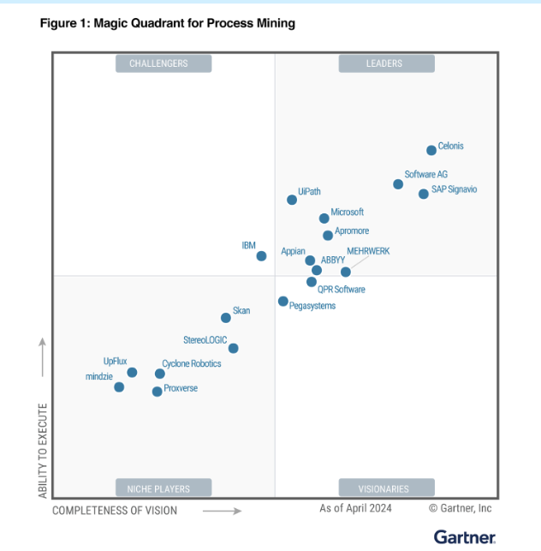
Conclusion
SAP Signavio recognized as a Leader in 2024 Gartner® Magic Quadrant™ for Process Mining Platforms for second year in a row.
Advanced AI capabilities
Prioritize and clearly communicate ROI
Automated root cause analysis
A redesigned process data pipeline-interface
Enhanced benchmarking analytics
Flexible dashboard filtering
Improved workflows
Notes:
The SAP Signavio February 2025 Release : Advanced features to help drive transformation
Advanced AI capabilities to simplify complex processes and deliver actionable insights.
Tools to calculate the monetary value of transformation initiatives, helping you prioritize and clearly communicate ROI.
Enhanced benchmarking analytics to compare your processes to industry standards and uncover opportunities for optimization.
Automated root cause analysis to identify performance drivers and resolve inefficiencies faster.
Expanded value analysis for process mining, exposing financial opportunities hidden in your data.
A redesigned process data pipeline-interface makes creating, integrating, and managing data workflows easier.
Flexible dashboard filtering for customized views that focus on what matters most to your role.
Improved workflows for creating connections, sourcing data, and building data with ease

Slide 24
Thank You !
Notes:
The SAP Signavio February 2025 Release : Advanced features to help drive transformation
Advanced AI capabilities to simplify complex processes and deliver actionable insights.
Tools to calculate the monetary value of transformation initiatives, helping you prioritize and clearly communicate ROI.
Enhanced benchmarking analytics to compare your processes to industry standards and uncover opportunities for optimization.
Automated root cause analysis to identify performance drivers and resolve inefficiencies faster.
Expanded value analysis for process mining, exposing financial opportunities hidden in your data.
A redesigned process data pipeline-interface makes creating, integrating, and managing data workflows easier.
Flexible dashboard filtering for customized views that focus on what matters most to your role.
Improved workflows for creating connections, sourcing data, and building data with ease

Slide 25

References
SAP Signavio - What is it? - SAP Community
Yamaha Motors: Driving growth and accelerating innovation through business transformation - SAP Signavio
Hilti Group: How Can Streamlining Processes Help Build a Consistent and Superior Customer Experience?
The SAP Signavio Suite
Top 10 SAP Signavio Alternatives & Competitors in 2025 | G2
SAP Signavio | 2024 Magic Quadrant for Process Mining | SAP News
OUT NOW: SAP Signavio February 2025 Release - Expl... - SAP Community
https://www.celonis.com/platform/process-mining/
https://www.igrafx.com/process-mining/
https://www.microsoft.com/en-us/power-platform/products/power-automate
https://aris.com/business-process-analysis/

